Slide 1

Formulating Corporate Strategies
Introduction to Corporate Strategy

Slide 2
Business Strategy and Innovation
Formulating Business Strategy
Objectives
To discuss the key issues addressed by Corporate Level Strategy and frameworks used by strategists to support strategic decision-making
To develop a understanding of different merger and acquisition strategies – vertical integration, horizontal integration, and diversification – and how these strategies impact organizational growth

Slide 3
Business Strategy and Innovation
Formulating Business Strategy
Topics
Introduction to Corporate Strategy
Firm Scope and the Allocation of Resources
Formulating Strategy: Vertical Integration
Formulating Strategy: Horizontal Integration
Formulating Strategy: Diversification

Slide 4
Reminder: Levels of Strategy
Corporate Strategy
Addresses which businesses an organization will be in, how resources will be allocated among those businesses, and how each business will relate to the other.
Business Strategy
Focuses on how to compete in a given business – directed towards achieving a sustainable competitive advantage
Functional Strategy
Concerned with the activities of the different functional areas of the organization and the short range methods to be used to help achieve the overall business strategy
Notes:
Corporate strategies follow the same grand strategies
as indicated for business units:
growth, stability, and renewal.
A growth strategy is a corporate strategy in which
an organization expands the number of markets served
or products offered either through
its current businesses or through new business.
Firms grow by using concentration,
vertical integration, horizontal
integration, or diversification.

Slide 5
Corporate level Strategy Issues
Scope of the Overall Firm
Allocation of Resources Across Strategic Business Units
Overall Firm Structure and the Extent of of Shared Services and Intra-SBU Cooperation
Establishment of SBU Specific Grand Strategies and Strategic Goals and Objectives
Strategic Alliances with other Firms

Slide 6
Formulating Corporate Strategies
Firm Scope and the Allocation of Resources (Part 1)

Slide 7
Setting the Overall Scope of the Firm
Activities Creating More Value Together than Separately
Strong Internal Capabilities
Sharing of Technologies and Resources
Cost-Effective Capital
Reinforcing a Strong Brand
Notes:
Probably the most important issue dealt with
at the corporate level is the overall scope of the firm.
This determines the businesses that the firm is in
and how the corporation as a whole
supports and enhances the value
of the business units within it.

Slide 8
Overall Scope of the Firm
Dimensions of Corporate Scope
  Important when competing in multiple industries
  Corporate strategy concerns the SCOPE of the firm
  Industry value chain – degree of vertical
  integration.
  Products and services – horizontal integration, diversification
  Geography – where to compete on the global stage.
Notes:
Let's the discuss the dimensions of corporate scope,
beginning with the industry value chain.
As will be described later in this topic,
the industry value chain depicts the transformation
of raw materials and the finished goods and services
delivered to customers and consumers.
The industry value chain encompasses for an industry
the supply chain that provides impetus to the firm
and the distribution channels to the firm's customers.
The issue is how much of the value chain
does the firm want to own and control.
Strategies here are referred to as
vertical integration strategies.
A second dimension of scope
relates to products and services.
Essentially, what markets does the firm
choose to participate in?
If the products or services are different
from the firm's core products and services,
this strategy's referred to as unrelated diversification.
If the products and services are related
or complementary,
then the strategies are referred to
as related diversification.
Horizontal integration is growth through
the acquisition of competitors,
a form of related diversification.
The third dimension or scope deals with place.
Where should the firm compete on the global stage?
This issue deals not only with markets,
say, expanding market reach into South America
for a consumer products company,
but also in terms of operations.

Slide 9
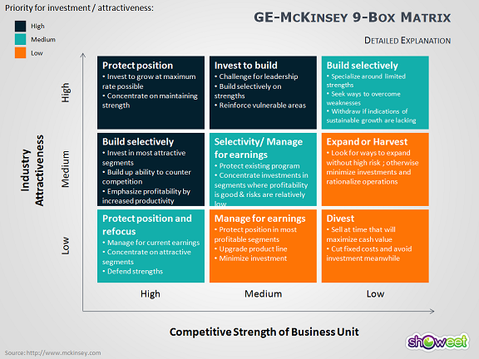
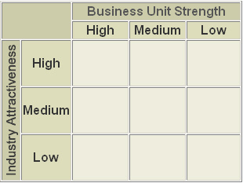
Corporate Strategy
  Capital Allocation Across Business Units
  The GE-McKinsey 9 Box Matrix
Notes:
The GE-McKinsey nine-box matrix
plots the firm's business units
according to the perceived strength on the x-axis
and market attractiveness on the y-axis.
Each axis has a low, medium and high categorization,
yielding nine distinct classifications.
Depending upon which particular classification or cell
that the business unit falls in,
they result in the default investment strategy
for that unit.
Let's look at what is meant by business unit strength
and industry attractiveness.
First, business unit strength.
Regarding business unit strength,
managers try to determine if a business unit
has a sustainable competitive advantage
or at least a temporary competitive advantage.
The following factors may be used to determine
the competitive strength of a business unit,
total market share, market share growth
compared to competitors,
brand equity, business unit profitability,
VRIO resources,
production flexibility,
and the strength of positioning
within the industry value chain.
Part of mapping business units,
managers need to agree to a scale for distinguishing
low from moderate from high.
This will likely be in the form of an index,
where the index values are assigned
to specific characteristics or factors.
Industry attractiveness indicates
how hard or easy it will be for the company
to compete in the market and earn profits.
The more profitable the industry is,
the more attractive it becomes.
When evaluating industry attractiveness,
managers should look at
how an industry will change in the long run
rather than in the near future
because the investments needed for the product
usually require long-lasting commitments.
Industry attractiveness consists of
many factors that collectively determine
the competition level within it.
Some common factors include industry growth rate and size,
trends and average industry profitability,
industry attractiveness
from the Porter analysis perspective,
industry lifetime stage,
and macroeconomic factors,
such as determined by PESTEL analysis.
Much of this analysis should be done
in the external analysis portion
of the strategic management process.
Similar to business strength,
managers should determine an approach
to indexing industry attractiveness
and determine index ranges for low, moderate and high.
Once the business units are plotted
in the nine-cell matrix,
future investment action in terms of
how capital is allocated
should proceed according to the classification
of each business unit.
Note that there are three basic strategies.
The harvest/divest shown here as the orange cells,
the investment strategy is either
to divest the business altogether
or limit investment to only the necessary funding
for sustaining the business up to that time
that the business can be harvested.
If a business unit in this category
generates surplus cash,
the surplus cash should be reinvested elsewhere
in a higher potential business unit.
The rules should be to only invest in those businesses
as long as investments into those businesses
don't exceed the cash generated from those investments.
The blue cells call for selective investment.
Corporate strategists should invest
into these business units
only if the firm has capital left over
after investments in the higher potential businesses.
For these cells, the general rule should be
to invest in business units which operate in huge markets
and where there are not many dominant players
in those markets.
In these cases, it is assumed that
additional investment would help win a larger market share.
Finally, the dark blue cells represent
the high potential business units.
Firms should invest into these business units
that fall into these boxes as they promise
the highest returns in the future.
Typically, these business units
will require a lot of capital
because of the operating and growing industries
and will have to maintain or grow their market share.
It is essential to provide as much resources as possible
for these business units,
so there will be no constraints for them to grow.
The investment should be provided for R&D,
advertising, acquisitions
into increased level of their production capacity
to meet the future demand.

Slide 10
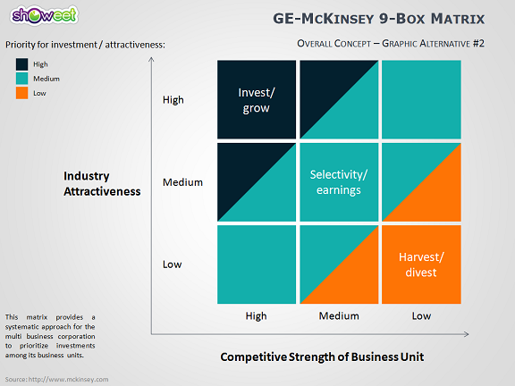
Corporate Strategy
GE-McKinsey 9 Box Matrix

Slide 11
Formulating Corporate Strategies
Firm Scope and the Allocation of Resources (Part 2)

Slide 12
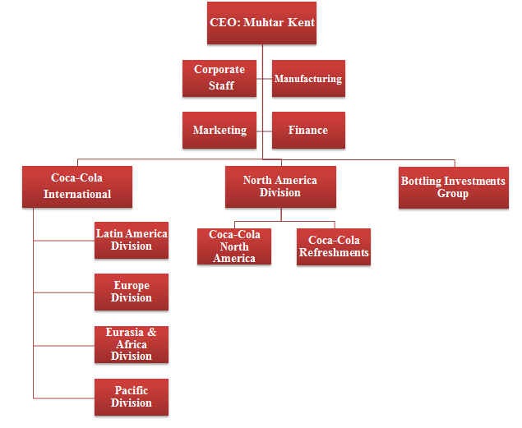
Corporate Strategy
Divisional Structure

Slide 13



Corporate Strategy
Shared Services
Corporate
Shared
Services
Commodity
Outsourcer
Scale and Efficiency
SBU
Managed
Services
Service Quality and Responsiveness
Determination and organization of shared services where functions that were once embedded within business units are pulled out shared across Business Units
The Objective: Cost reduction by creating efficiencies from specialization and standardization, economies of scale, and eliminating redundancies.
Notes:
Shared functions are services as an operation philosophy
that involves centralizing specific staff
and administrative functions that either once were
or could be performed separately,
within the individual business units.
Ideally, firms that implement shared service strategies
enjoy significant cost savings by standardizing practices
and procedures by creating economies of scale.
Performing a function in a more centralized setting
usually requires less investment in technology
and office space, as well as fewer employees
that perform in the same function in multiple locations.
Also, highly expert skills can be optimized
by leveraging across business units,
rather than underutilized in a decentralized setting.
The trade-off is essentially in terms
of management controls
and business unit specific specialization, versus cost.
A decentralized approach is typically more costly,
since redundant capabilities will exist
across the business units.
But direct management control
by business unit senior executives can improve
and result in higher responsiveness.
In most cases, shared services organizations
charge the different business units
for the use of their services,
but the overall aggregated cost of the shared services
will typically be less than if the services
were housed completely within each business unit.
So, because of the trade-offs,
the decision to create shared services
resides at the corporate level, not the SBU level.
Issues include what support services to share,
how to charge the SBUs for those services,
the framework for establishing planned service levels,
and intra-SBU shared service center conflict escalation
and resolution approaches.

Slide 14
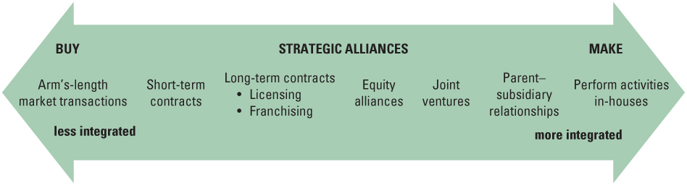
Corporate Strategy
Corporate Strategy Issues
Overall Firm Structure
Should a firm do things in-house, or obtain externally
If C in-house < C market, then the firm should vertically integrate. If C in-house> C market the firm should contract out or partner
Source: Strategic Management Concepts and Cases by Frank K. Rothaermal
Notes:
Finally, developing an outsourcing strategy to complement
or replace an internal corporate shared services
is also an option evaluated at the corporate level.
Traditionally, this evaluation has been driven
by financial considerations, taking assets
off the balance sheet while creating a more predictable
and lower operating cost stream.
And today, commodity outsource will serve that role.
For example, if the cost of performing a function in-house
is less than the cost of procuring that service
from the market, then the firm should perform in-house
or vertically integrate and acquire the function
to perform in-house.
Arrangements here tend to be more in the form
of an alliance or business partnerships.

Slide 15
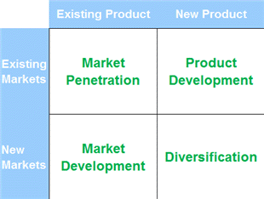
Corporate Strategy
Ansoff’s Matrix
New Product Lines
or Businesses
Attacking New Segments with New Products
Acquisitions of complementary and non-complementary firms
Vertical integration
Acquire direct competitors
Globalization
Business Alliances with Complementary Firms
Notes:
As discussed in our topic on business level
strategy formulation, Ansoff's Matrix
has four alternatives for growth:
market penetration, product development,
market development, and diversification.
These strategies are also relevant at the corporate level.
Market penetration strategies cover existing products
targeted toward existing market segments.
A corporate growth strategy here would be
to acquire a merge with a competitor firm,
called horizontal integration.
This will be the subject of our next video lesson.
Market development strategies could include
expanding into new geographic territories
or going multi domestic international.
Marketing development may also be achieved
through creating business alliances
and joint marketing agreements with complementary firms.
Creating joint economies of scale
by sharing distribution channels is yet another example.
In product development, the emphasis here
is on creating and entirely new product lines
and consolidating the new products,
either to existing strategic business units,
or launching a new business altogether
to house the new product.
A proven strategy for launching a disruptive product
is to isolate the product from the core businesses
and to place it into an entirely new structure.
In diversification, the firm grows
by selling new product lines into new markets.
The product lines may be related or complementary
to the firm's core business, called related diversification,
or may be a significant departure
from the firm's core business,
called unrelated diversification.

Slide 16
Vertical Integration (Part 1)

Slide 17
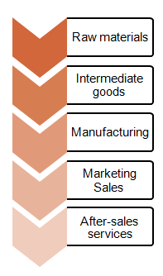
Vertical Integration
A primary element of Corporate Strategy and future growth strategies is determining what stages in the industry’s value chain should the firm compete.
The Industry Value Chain depicts the transformation of raw materials into finished good and services delivered to customers and consumers. Along the value chain there are distinct stages each of which typically represents a distinct industry
Vertical Integration is the extent of firm ownership of its production of needed inputs or the channels by which it distributes it outputs.
Primary considerations are cost and competency related
Source: Strategic Management Insights
Notes:
Vertical integration is a strategy that many firms use
to gain control over their industry's value chain.
Vertical integration is a strategy that many firms use
to gain control over their industry's value chain.
This strategy is one of the major considerations when
developing corporate level strategy.
The important question in corporate strategy is
whether the company should participate in one activity,
one industry, or many activities, many industries
along the industry value chain.
For example, the firm has to decide if it only manufactures
its products, or should it also engage in retail and
in after-sale services.
Two issues have to be considered
regarding vertical integration.
Cost, as mentioned in a earlier lesson, an organization
should vertically integrate when the cost of making
the product inside the company are lower than the cost
of buying that product in the market.
Second, scope of the firm.
A firm should consider whether moving into new industries
would dilute its current competencies or not.
New activities in a company are also
harder to manage and control.

Slide 18
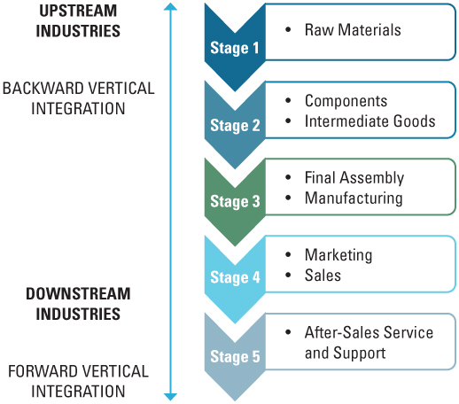
Vertical Integration
Source: Strategic Management Concepts and Cases by Frank K. Rothaermal
Notes:
Vertical integration can be either forward or backward
in the industry value chain.
Let's spend a minute and discuss considerations in
pursuing a vertical integration strategy.
First, let's start with forward integration.
If the manufacturing company engages in sales
or after-sales industries, it pursues
a forward integration strategy.
This strategy is implemented when the firm wants to achieve
higher economies of scale and larger market share.
The internet and virtual distribution channels have provided
many organizations with the opportunity to easily
integrate forward, assuming roles once reserved for
distributors and retailers.
A forward integration strategy is effective when
there are few quality distributors available in the industry
when distributors or retailers have high profit margins,
in this case, capturing a larger portion of industry profits
drives the vertical integration strategy.
When distributors are very expensive, unreliable, or
unable to meet the firm's distribution needs, or when
the industry is expected to grow significantly, or when
access to customers improve customer insights and future
product development, also when direct customer input
improves the ability to forecast future demand, enhancing
and improving operational marketing-related decision making.
It's also important that the firm has enough resources and
capabilities to manage the new combined businesses.
When the same manufacturing company starts making
intermediate goods for itself, or takes over its previous
suppliers, it pursues backward integration.
Firms implement backward integration strategies in order
to secure stable inputs of resources and become
more efficient.
Backward integration strategy is most beneficial when
firms current suppliers are unreliable, expensive, or
cannot supply the required inputs,
when there are only a few suppliers but many competitors in
the industry,
when the industry is expanding rapidly,
when the prices of inputs are unstable,
when suppliers earn high profit margins,
and again, it's also important that the firm has
the necessary resources and capabilities
to manage the new combined businesses.
Vertical integration is a difficult strategy for companies
to implement successfully.
It's often expensive, and it's hard to reverse.

Slide 19
Vertical Integration (Part 2)

Slide 20
Benefits and Risks of Vertical Integration
Benefits
  Secures critical supplies and distribution channels
  Creates a source of differentiation
  Lowers costs
  Improves quality
  Facilitates scheduling and planning
  Facilitates investments in specialized assets
  Captures greater profits (profits that would typically accrue to 3rd parties)
Risks
Increases costs and or reducing quality
Capacity balancing issues
Internal suppliers lose incentives to compete
Requires different core competencies
Reduces flexibility
Requires substantial capital
Slow to respond to changes in technology or demand
Notes:
In general, the benefits of Vertical Integration
come from the greater capacity it gives organizations
to control access to inputs including the cost,
quality and delivery times of those inputs.
In line with the changing organizational structure
of the late 20th century however,
this logic has become less compelling.
Let's gain some historical perspective here.
Starting with Henry Ford and the Model T,
a centralized command and control
business and operation strategy began to take hold
in U.S. manufacturing.
This movement was consistent with Taylorism
and the Classical Management Theorists.
Vertically integrated businesses leveraging
mass-production principles of efficiency
dominated the corporate world until the latter part
of the 20th century.
Vertical Integration gives the firm more control
over the business.
One great benefit that is sought by firms
that are getting into Vertical Integration
is more control over the value chain.
When retailers decide to develop or acquire
a manufacturing business they gain more control
over the production aspects of their distribution processes.
In the same manner, when manufacturing companies
perform retail in their distribution,
they have more control over how their products
are merchandised.
Apple's Apple Store initiative was partially driven
by the desire to better merchandise Apple's products.
Vertical Integration also allows
for positive differentiation.
This business strategy could give an organization
an important access to more productive inputs,
process and retail channels, and distribution resources.
Each of these elements could offer opportunities
to the firm to distinguish itself from the competition
with the use of a more effective marketing
and distribution tactics.
For a retail business, it can adopt more quickly
to the changing consumer needs by owning
a production or manufacturing firm
that can create its own products.
For manufacturers, they can sell through the web
and take advantage of online advertising techniques
to drive traffic to their sites
and to build market credibility.
It requires lower cost of transactions.
This can be realized through intercompany
transactions that can be made between
subsidiaries that typically have
a central communication management system.
Also intercompany profits are eliminated
with Vertical Integration and accrue totally
to the integrated firm.
Vertical Integration offers more cost control.
Typically, Vertically Integrated firms
can offer significant ability to control costs
and the distribution of products,
particularly the traditional ones where every step
in the movement of the goods involves mark-ups.
Through direct selling to in-buyers,
manufacturers could get rid of the middle man
which means a step or more removed
in the process along the way.
A single entity that manages the distribution process
will also have more ability to optimize
the utilization of resources and avoid wasted cost.
Not only these, but lower transportation costs
will also be common.
On the other hand however, cost disadvantage
can result from Vertical Integration
including lower economies of scale since activities
at different stages of the production process
can be very different, and Vertically Integrated
operations may be less efficient mainly due to the
dilution of the firm's core competencies.
Another benefit of Vertical Integration
is that it insures a high level of certainty
when it comes to the quality.
It also provides more competitive advantages.
Some businesses get into Vertical Integration
with the sole purpose to increase their competitive
advantage over their competitors and block them
from gaining access to important markets
and scarce resources.
For example, a retailer may purchase a manufacturing
firm to gain access to their resources, patents
and proprietary technology that firm owns.
For manufacturers, they may enter retailing
and distribution to get direct access to customers
in a highly competitive market before the competitors do.
But there are counter-balancing risks as well,
including potentially higher costs
and principal agent issues.
Capacity balancing problems.
A good example of this situation is when a business
needs to establish excess upstream capacity
to insure that its' downstream operations
will get sufficient supply under any demand condition.
This might even result in retaliation
of the business's former suppliers,
potentially endangering its main production.
Vertical Integration can bring about more difficulties
as noted before, vertical managers will have less
economies to scale as much of their production
processes are at different levels now.
It can result in decreased flexibility.
The main contributors to this problem
are the upstream and downstream investments
that the business is making.
Vertical Integration could cause confusion
within the business and overall management issues.
Retail and product development are distinct businesses
requiring different core competencies,
strategic assets, partnerships and economic models.
Management issues become far more complex
overseeing a Vertically Integrated business
versus a business focused on a single stage
of the industry value chain.
Vertical Integration requires a huge amount of capital.
For Vertical Integration to happen,
the firm should have large amounts of capital to invest.
After all, the firm may have to purchase new facilities,
hire a large number of new employees
and control their new facilities,
making this strategy nearly impossible
for smaller companies to employ.
Mergers may reduce capital requirements
but acquisitions have to be paid for.

Slide 21
Horizontal Integration

Slide 22
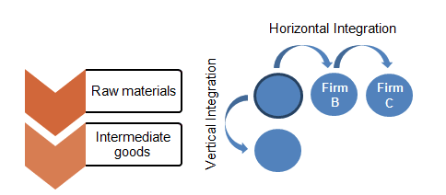
Horizontal Integration
Horizontal Integration is the process of acquiring or merging with competitors.
Source: Strategic Management Insights
Examples:
Bank of America and NationsBank - Financial Services
Pfizer and Wyeth – Pharmaceuticals
AT&T with T-Mobile USA –Telecomm
RockTenn with MeadWestvaco – Paper and Packaging
Kraft Foods and Cadbury – Foods
HP and Compaq – Personal Computers
Lenova buying IBM PC business – Personal Computers
Google acquiring Youtube – Internet
Disney acquires Pixar -- Entertainment
Notes:
Horizontal integration is the process of acquiring
or merging with competitors.
A merger is the joining together of two independent
companies to form a combined entity.
In a merger, the firms are usually of similar size.
One goal of a merger is to achieve management synergy
by creating a stronger management team.
An acquisition, friendly or hostile,
is the takeover of one company by another.
Here the purchased firm loses its identity.
The acquired company and its assets may be absorbed
into an existing business unit or remain intact
as an independent subsidiary within the parent company.
Acquisitions usually occur when a larger firm
purchases a smaller company.
Unfriendly mergers, or hostile takeovers,
occur when the manager of the firm targeted
for acquisition resist being purchased.
Horizontal integrations are more common
and simpler than vertical integrations.
Shown here are some recent examples
of horizontal integration.
Using horizontal integration, a firm can grow the company
in size, increase product differentiation,
achieve economies of scale,
reduce competition or access new markets.
When many firms pursue this strategy to save industry,
it leads to industry consolidation.
This is a typical characteristic of a touring industry.
Horizontal integration may be an effective strategy
when the firm competes in a growing industry,
when competitors lack some capabilities
or competentlessly skills or resources
that the company already possesses.
When economies of scale would have a significant effect,
it's also important that the organization has
sufficient resources to manage to combine companies.

Slide 23
Benefits of Horizontal Integration
  Reduction in competitive intensity by increasing industry concentration and the reduction of excess capacity
  Lower costs through economies of scale
  Increased differentiation by filling gaps in the acquiring firms product and service offering
  Access to new markets and channels often through geographic expansion
Notes:
Mergers and acquisitions are popular strategies
for firms that desire to overcome a competitive disadvantage
or because the acquired firm has developed superior
integration capabilities.
It is an integration strategy pursued by a company
in order to strengthen its position in the industry.
Horizontal integration strategy generally can be done
by businesses which have established themselves
and have a stable life as compared to ones which are
still addressing risk on a regular basis.
The media advantages of implementing horizontal integration
are to have economies of scale,
to expand the firm's knowledge and capabilities,
to increase market and profits,
to reduce competition by merging with the competition
rather than competing against the competition.

Slide 24
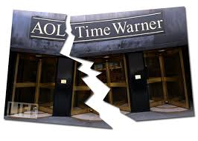
Integration Strategies Case Study – AOL/Time Warner
Integration Failure – In many cases the proposed synergies of an integration strategy never materialize and shareholder value is destroyed rather than created.
Example: AOL-Time Warner destroyed $91 Billion in shareholder value

Slide 25
Diversification (Part 1)

Slide 26
Diversification
Diversification is growth by expanding the range of products, services, or markets in which a firm competes.
Three general diversification strategies
  Market diversification. Active in several market segments or different geographical locations
  Product diversification. Active in several different product categories
  Product – market diversification. Active in a range of both product and markets.
Notes:
There are three general diversification strategies.
One form of diversification is to sell existing products
into new markets.
In this discussion we are calling this
market diversification.
In market diversification, a firm may elect
to broaden its geographic base to include new customers,
either within its domestic markets
or in international markets.
In market diversification, firms may also choose
to re-segment, or pursue new markets altogether
for its product line.
A business could also pursue a diversification strategy
by finding new uses for its existing product.
The use of baking soda to keep refrigerators fresh
is an example here.
Another form of diversification is to market new products
in existing markets.
Here we refer to it as product diversification.
Generally this strategy involves using
existing channels of distribution to market new products.
Finally we have product market diversification.
This strategy requires a company to enter a new market
where it is not established,
and the firm is also introducing,
at least to the firm, a new product.
Research and development costs as well as advertising costs
will likely be higher
than if existing products were marketed.
In effect, the investment and the probability of failure
are much greater when both the product
and the market are new.
For this reason, this is why this diversification strategy
in the Ansoff Matrix is referred to as the suicide sell.

Slide 27
Diversification
Why Diversify
Create Economies of Scale and Scope
Better Leverage Managerial Skills
Cross Subsidize Products
Spread Financial Risks Over Different Markets
Notes:
However, there are many reasons why a firm
may want to pursue a diversification strategy.
First, companies might wish to create
and exploit economies of scale,
in which the company tries to utilize
its existing resources and capabilities in other markets.
This can be the case if companies
have underutilized resources or capabilities
that cannot be easily disposed of or closed.
Using a diversification strategy, companies may therefore
be able to utilize all of its capabilities
or resources, and be able to attract new businesses
for market segments not catered to earlier.
Second, managerial skills found within the company
may be successfully used in other markets,
where the dominant logic
and the current managerial procedures
can be successfully transferred to those markets.
Third, companies pursuing a diversification strategy
may be able to cross-subsidize one product
with a surplus of another.
This way, companies with a very diverse portfolio
of products catering to different markets
may potentially grow in power, and be able to withstand
a prolonged period of price competition.
And fourth, companies may want to use
a diversification strategy to spread financial risk
over different markets and products,
so that the entire success of the company
is not relying on one market or product only.
However, it is important for companies to realize
the possible danger to diversifying
its scope of operations too much.
A firm might risk neglecting its core capabilities
and become too diversified, where too many products,
or too many different products,
supplied to different markets, have negative effects
on the current products and services,
or where product quality or uniqueness suffers
due to the shift in focus.

Slide 28
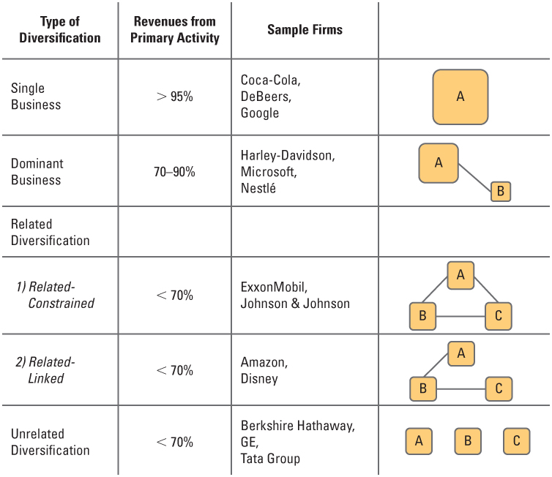
Different Types of Diversification
Notes:
This graphic shows a range of diversification options
for the firm.
A single business is not diversified.
A barbecue restaurant, for example,
is a non-diversified business model.
A large business can also be non-diversified,
an example being Avon,
a provider of women's cosmetic products.
Other examples include Coca-Cola and Google.
For all these firms, over 95% of their revenues
come from a single line of business.
A dominant business pursues multiple business activities,
but is dominated by a single line of business.
Harley-Davidson is an American motorcycle manufacturer,
but also has clothing lines, restaurants, and sells
motorcycle accessories, in secondary businesses.
A firm is diversified if less than 70% of its business
comes from its largest line of business.
Diversification can take a number of forms,
including related diversification,
and unrelated diversification,
so let's discuss related diversification first.
Related diversification occurs when a firm adds
related products or markets to achieve strategic fit.
This occurs when companies expand their operations
beyond current markets, but are operating within
existing capabilities.
Strategic fit allows an organization to achieve synergy.
In essence, synergy is the ability of two or more parts
of an organization to achieve greater effectiveness
together, than they would have experienced
if their efforts had remained independent.
Combining firms with complementary marketing,
financial operating, or management effort
is an example here, where synergies can be reached.
Another example is combining organizations that can share
the same supply chain,
or approach to sales and distribution.
A car manufacturer might expand its operations
into manufacturing of motorcycles or trucks.
Vertical integration, where firms move forward or backward
in the industry value chain, is a form of diversification,
as each stage of the value chain typically
produces different products,
for producers facing different sets of competitors.
Another form of synergy is financial synergy.
Financial synergy may be obtained by combining a firm
with strong financial resources
but limited growth opportunities,
with a firm having great market potential,
but weak financial resources.
For example, debt-ridden companies may seek to acquire firms
that are relatively debt-free to increase
the leverage firm's borrowing capacity.
Similarly, firms sometimes attempt to stabilize
earnings by diversifying into businesses
with different seasonal or cyclical sales patterns.
Strategic fit in operations could result in synergy
by the combination of operating units
to improve overall efficiency.
Yet another way to improve efficiency is to diversify
to an area that can use by-products
from the existing operations.
For example, brewers have been able to convert grain,
a by-product of the fermentation process,
into feed for livestock.
Management synergy can be achieved when management
experience and expertise is applied to different situations.
Unrelated diversification is where the firms expand
their operations into markets or products
beyond current resources and capabilities.
This strategy is sometimes referred to
as a conglomerate strategy.
Unrelated diversification is applicable
if the parent company is able to provide
different businesses with managerial knowledge
and expertise that strengthens the individual businesses.
One of the most common reasons
for pursuing a conglomerate growth strategy
is that the opportunities
in the firm's current line of business are limited.
Finding an attractive investment opportunity
requires the firm to consider alternatives
in other types of businesses.
Firms may also pursue a conglomerate
diversification strategy as a means of increasing
a firm's growth rate.
Growth and sales or profitability may make the company
more attractive to investors.
Growth may also increase the power and the prestige
of the firm's executives.
Conglomerate growth may be effective
if a new area has growth opportunities
greater than those available
in the existing line of business.

Slide 29
Diversification (Part 2)

Slide 30
Diversification: Sources of Value Creation and Costs
Sources of Value Creation Sources of Costs
Economies of Scale Coordination Costs
Economies of Scope Influence Costs
Restructuring
Internal Capital Markets
Restructuring Coordination Costs
Internal Capital Markets Influence Costs
Related
Diversification
Unrelated
Diversification
Notes:
Diversification strategies can be a source of value creation
if the individual businesses are worth more under the
firm's management than if each were managed individually.
Let's discuss both the sources of value creation,
from a diversification strategy and the incremental cost
of managing separate businesses
under a common management structure.
The chart illustrated here lists the sources of
value creation and the costs for two
diversification strategies, related and unrelated.
The source of benefits, economies of scale and economies of
scope have already been discussed so let's focus on
restructuring and internal capital market benefits.
Restructuring is reorganizing and divesting business units
and activities to refocus a company in order to better
leverage its core capabilities.
The GE-McKinsey matrix discussed earlier for supporting
capital allocation decisions is a helpful tool
for this process.
Excess cash can be diverted from mature businesses into
businesses that are growing but are cash-strapped.
Low performing businesses may be jettisoned.
In this way, corporate-level senior management can adjust
its investment levels and various SBUs
in a matter consistent or similar to
an individual investor rebalancing asset classes
in their own investment portfolio.
Internal capital costs.
Here corporate does a more efficient and effective job
at allocating capital through its budgeting process
than could be achieved in independent capital markets.
This improves the utilization of capital.
Based on internal-to-the-business information,
corporate-level managers are in the best position to
identify business units that provide the best return
on invested capital in those opportunities across the
business units that provide the greatest internal
rate of return on capital.
This visibility should lead to better capital allocation
decisions than would be made by investors viewing
each business in isolation.
A key difference between related diversification and
unrelated diversification is that, although while
both strategies may create value through restructuring
and internal capital markets, only related diversification
can also create economies of scope and scale.
Influence cost.
Political maneuvering by managers to influence capital
and resource allocation decisions can result in suboptimal
allocations of scarce resources.
Competition between strategic business units for resources
may entail shifting resources away from one division
to another.
Such a move may create rivalry and administrative problems
between the units.
Caution must also be exercised in entering businesses
with seemingly promising opportunities,
especially if the management team lacks experience or skill
in that new line of business.
In these situations, senior corporate managers may be misled
by more knowledgeable but biased business unit managers.
Coordination costs are a function of the number, size
and types of business that are linked one to another.
Probably the biggest disadvantage of an unrelated
diversification strategy is the increase in administrative
problems associated with operating different businesses.
Managers from different divisions will have
different backgrounds and may be unable
to work together effectively.
Without some knowledge of the new industry, a firm will be
unable to accurately evaluate the industry's potential.
Even if the new business is initially successful,
problems may eventually occur.
Without some form of strategic fit, the combined performance
of the individual units will probably not exceed the
performance of the units operating independently.
In fact, combined performance may deteriorate because of
controls based on the individual units
by the pair of conglomerate.
Decision making may become slower due to longer reviews
and more complicated reporting systems.

Slide 31
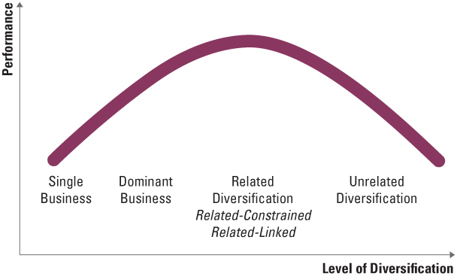
Different Types of Diversification
Research has shown that diversification-performance is a function of the
underlying type of diversification
Notes:
In this simple chart, the relationship between
the type of diversification and the overall
firm performance is depicted.
Note that the performance peaks with moderate levels of
diversification and specifically, related diversification
and that the overall firm performance tends to be lower
in situations of little diversification or in cases of
extreme unrelated diversification or conglomeration.
To generalize the benefits of the incremental value
created by increasing diversification becomes eroded.
It becomes eroded by the increasing coordination and the
influence cost incurred in managing very different
types of businesses.

Slide 32
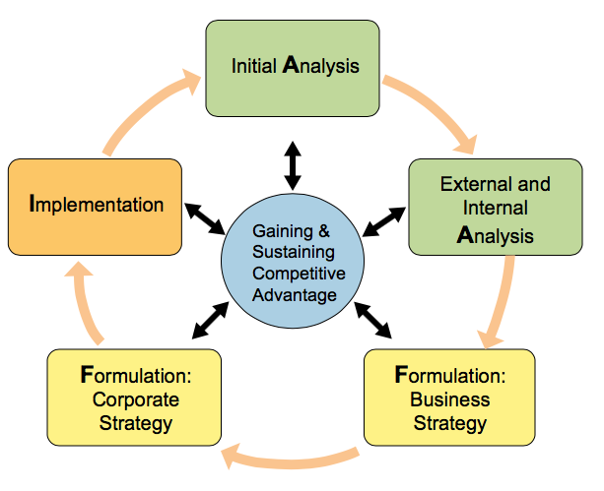
The AFI Framework
A
F
I
nalsis
vision, mission, values, external and internal analysis
corporate, business, and functional strategy
ormulation
structure, culture, processes, capabilities technology, governance and controls, and business ethics
mplementation
Notes:
The most strategic issue addressed by corporate strategy
is the scope of the overall firm.
Corporate executives determine the scope of the firm
in order to enhance their opportunities to gain and sustain
a competitive advantage.
In assessing scope, the senior managers assess vertical and
horizontal integration opportunities and then identify and
fund initiatives to implement the strategy.
Increasing the scope of the firm may be accomplished
internally through innovation or by
acquisition, alliances, business partnerships or merger.
Growth objectives for SBUs are established at the
corporate level.
Then SBUs develop business strategies to
reach those objectives.
Business strategies are driven by strategic positioning
and developing and leveraging core competencies
to create a competitive advantage.
Innovation is key here as a business pursues innovation
in the form of existing product improvements,
greater organizational and business process efficiency
and occasionally radical or disruptive innovation
to create new product categories,
in either existing or new markets.

